Slide 1
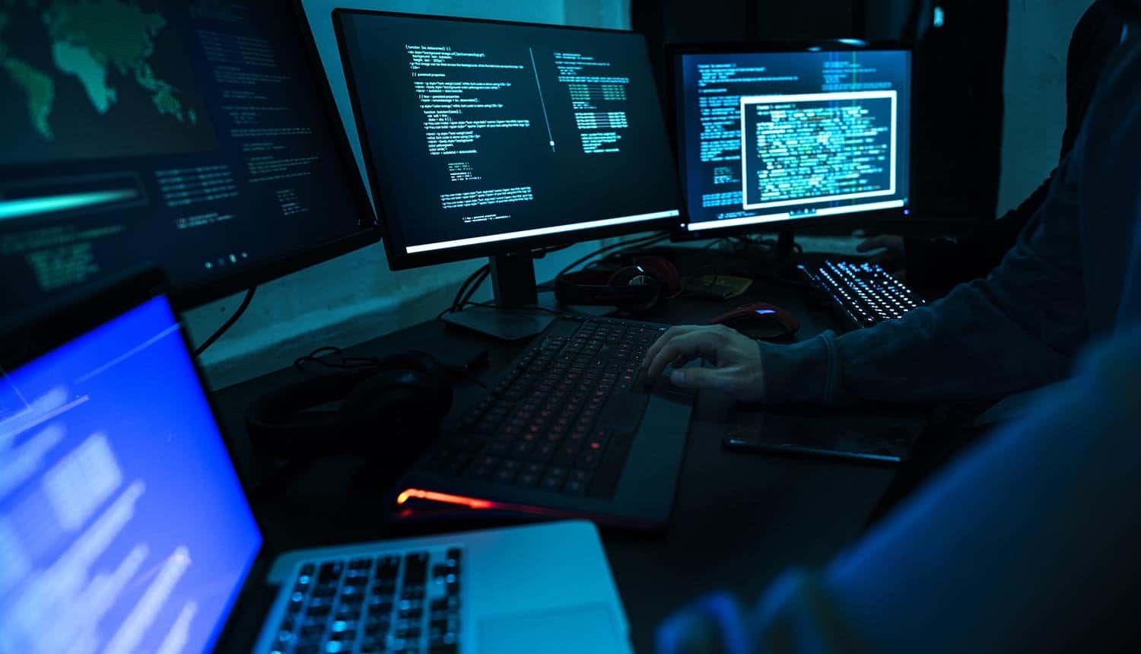
skin

Slide 3
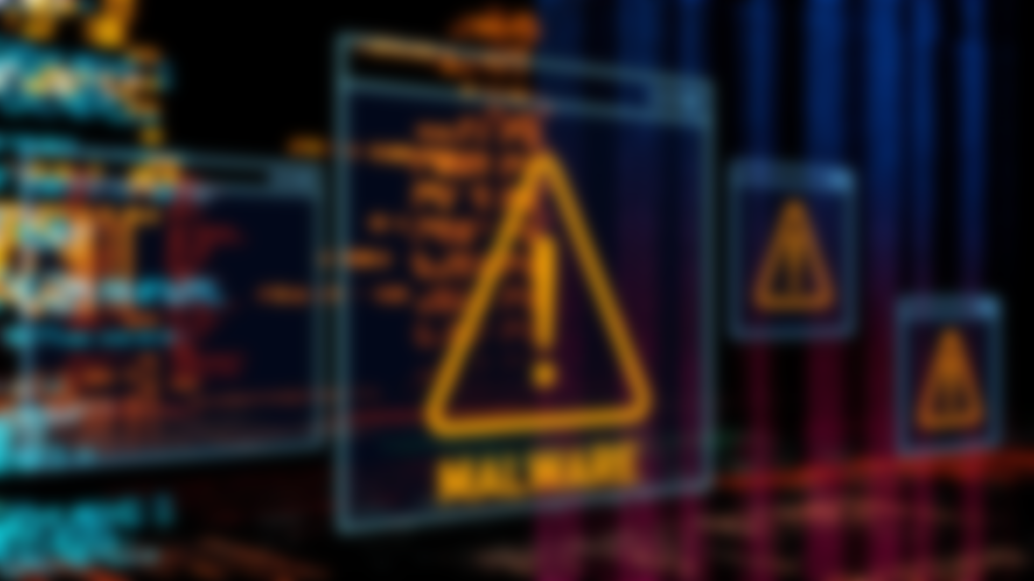

Slide 4
The World's Biggest Malware Attack:
WannaCry Ransomware
- a global crisis in May 2017
- infecting over 300,000 computers across
150 countries
- demand for ransom in Bitcoin
- exploited a Server Message Block (SMB) remote code execution vulnerability in Microsoft Windows computers (MS17-010),
- economic losses up to 4 billion usd

Slide 5
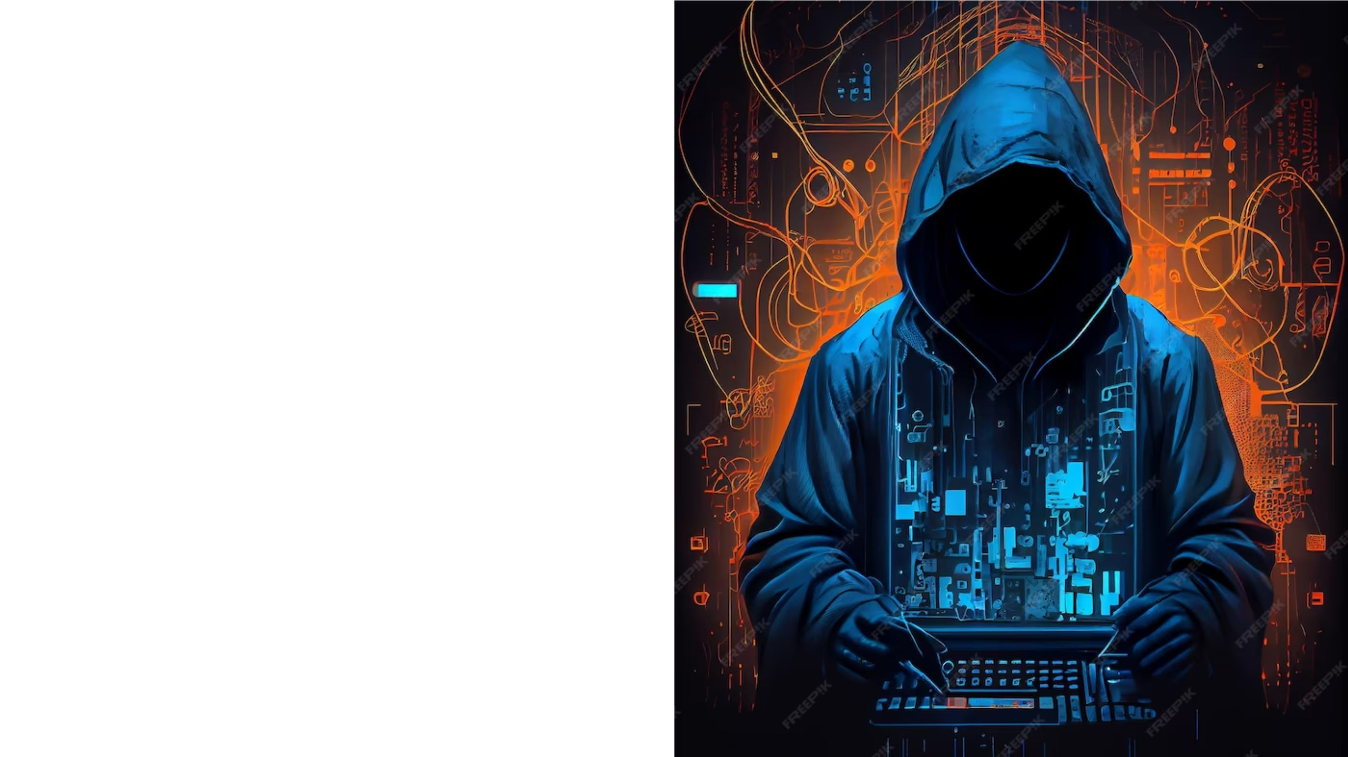
Prevention & Safety awareness from Malware
- Regularly updating and patching software and operating systems to fix security vulnerabilities.
- Installing and updating a reputable antivirus
- Being cautious of unexpected emails and avoiding clicking on suspicious links
- Installing and updating a reputable antivirus
- Regularly backing up important data.
- Using strong, unique passwords for all accounts.
- others

Slide 6
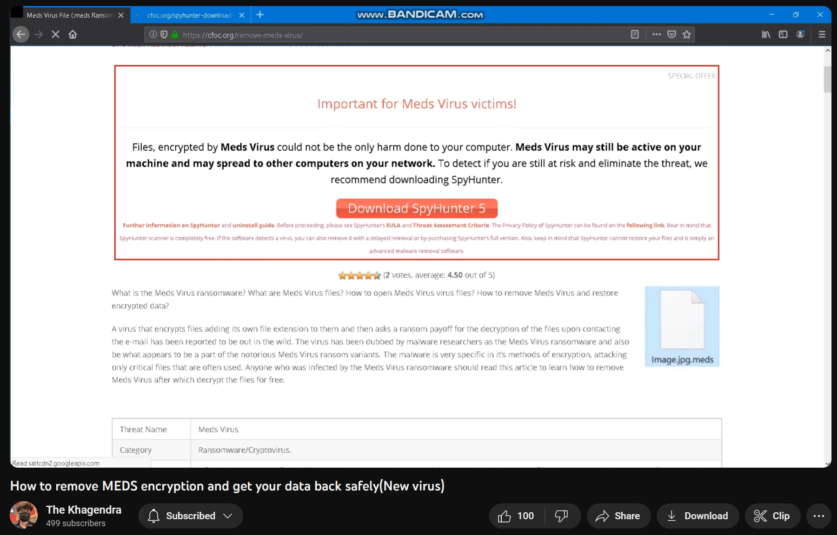

Slide 7
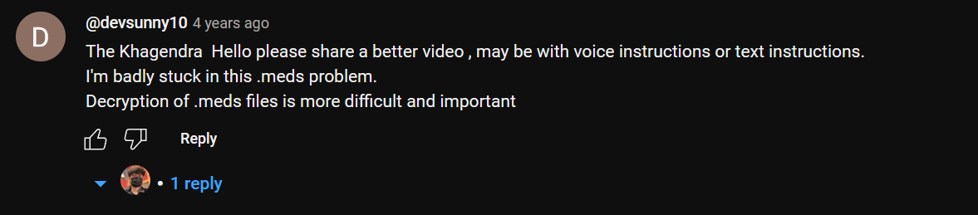
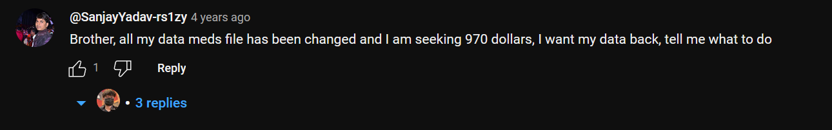
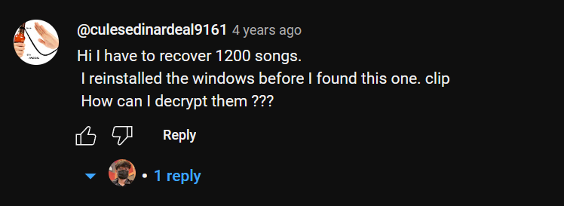


Slide 9


Slide 10
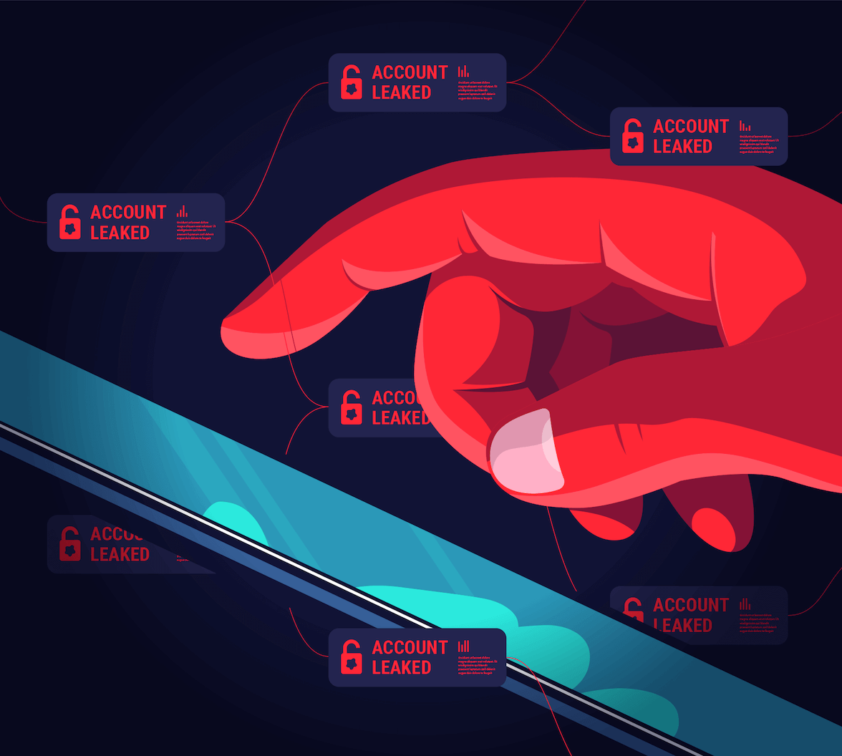

Slide 11


Slide 12
Deepfake Attack on UK Energy Company
- In 2019, the CEO of a UK energy company
- received a phone call from someone who sounded exactly like his boss
- convinced that the CEO transferred $243,000 to a "Hungarian supplier” to a scammer bank account

Slide 13


Slide 14
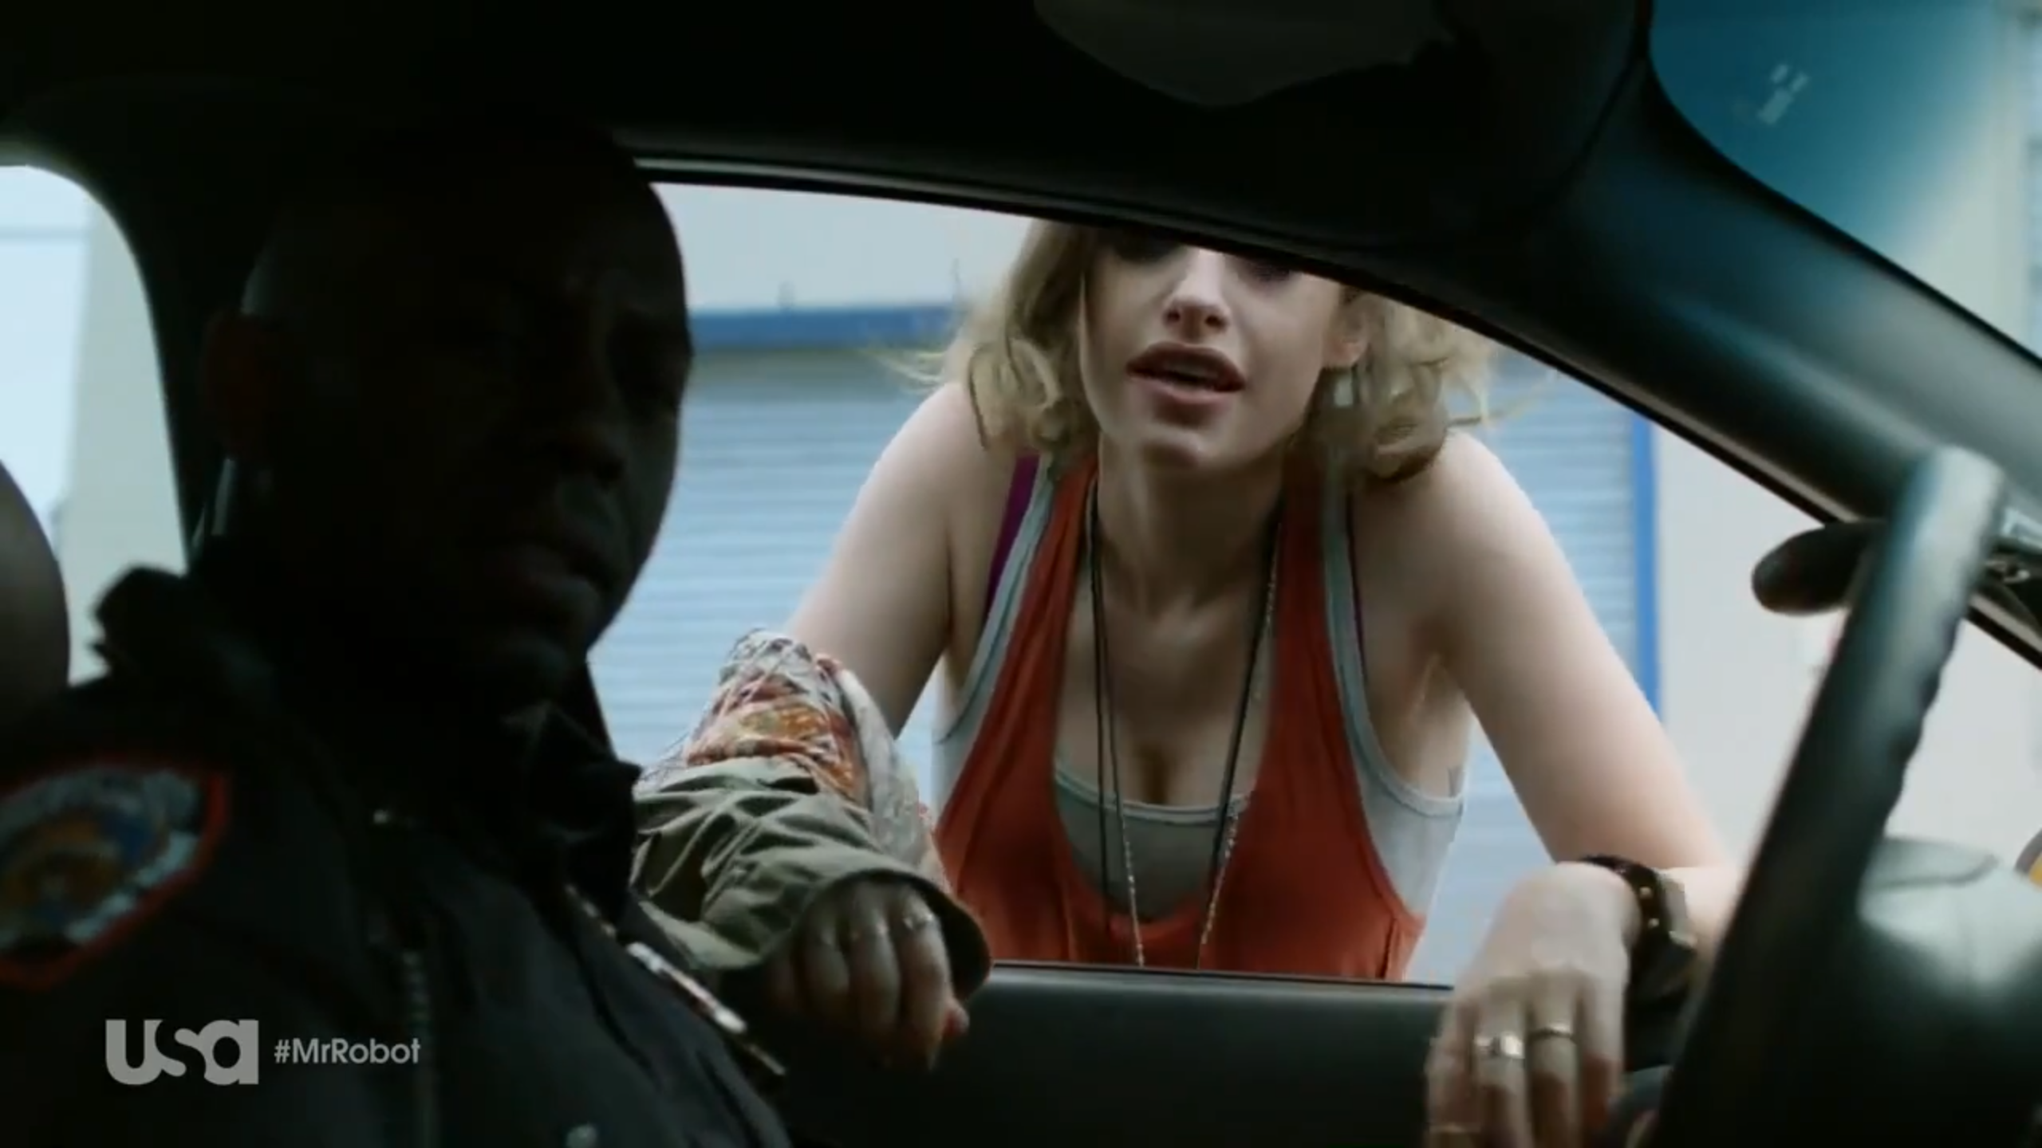

Slide 15
Video Slide

Slide 16
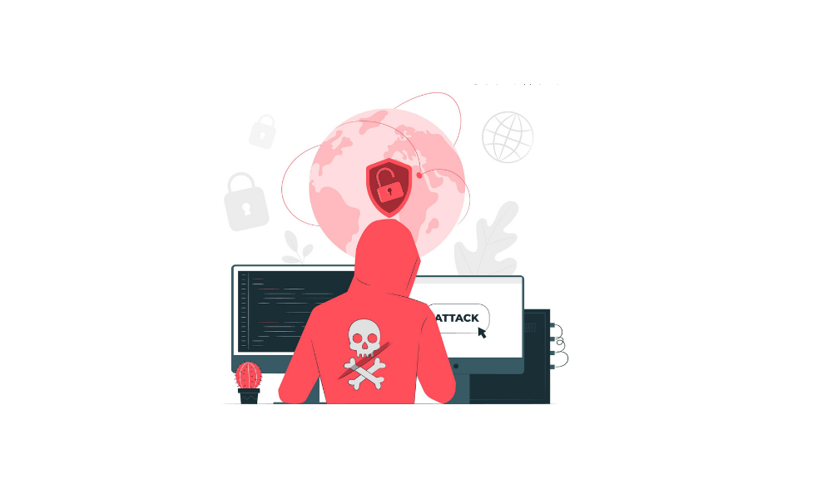
Verify Requests for Sensitive Information
Use a good spam filter
Creating a culture of security awareness
Recognizing Common Social Engineering Tactics
Verify Requests for Sensitive Information
Prevention from Social Engineering Attacks

Slide 17
Takeaway from Presentation

Slide 18


Slide 19


Slide 20


